Slide 1
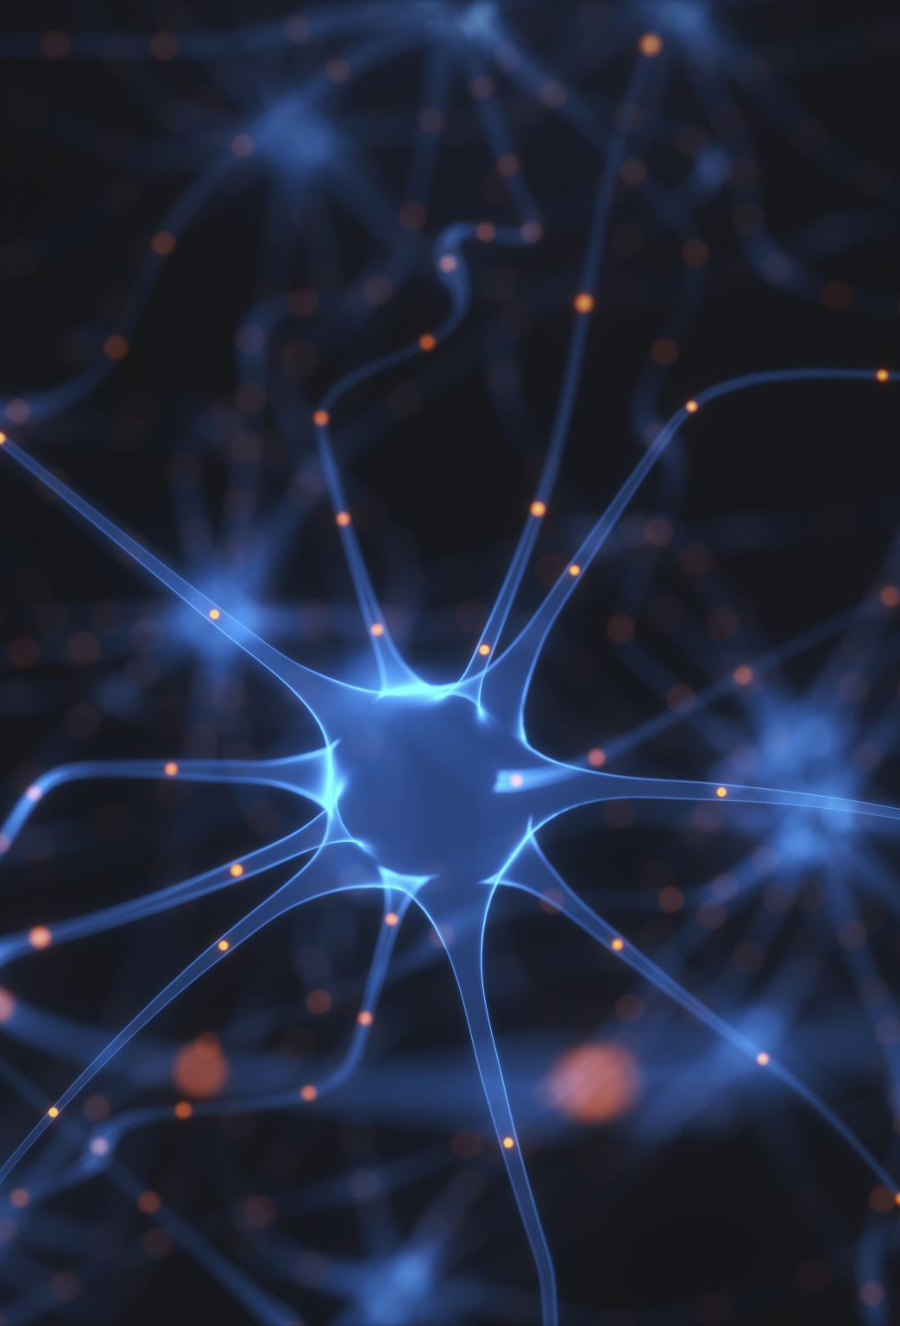
Leveraging Neural Networks for Advanced Image Classification in Healthcare
MSc Health Data Science
PMIM702 Health Data Presentation
Hyder Al-Hashimi – 1914644

Slide 2
The Foundation
AI is an extremely powerful tool that is exponentially growing, the aim is to utilise AI within the healthcare environment, providing better healthcare outcomes by:
- Spotting issues early
- Saving hospitals time and resources
- Providing more accurate diagnoses
The purpose of my research to gain a deeper knowledge understanding of neural networks by building one from scratch, developing my model step-by-step to the point where it can be applied to medical imagery, in this case brain tumour detections

Slide 3
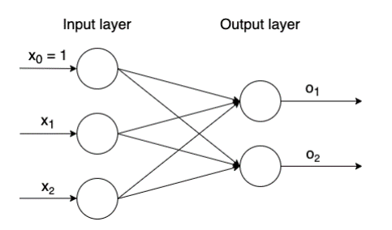
Perceptron

Slide 4
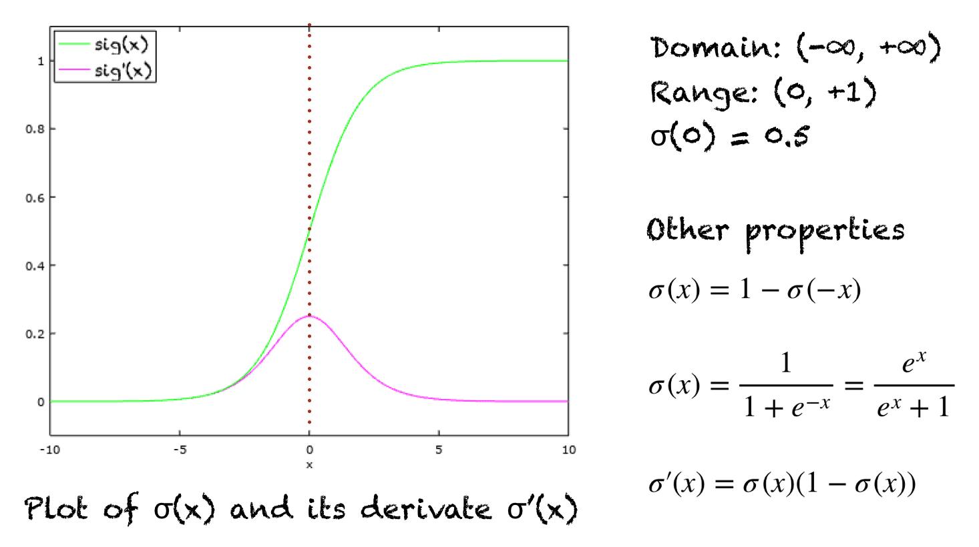
Sigmoid Activation Function

Slide 5
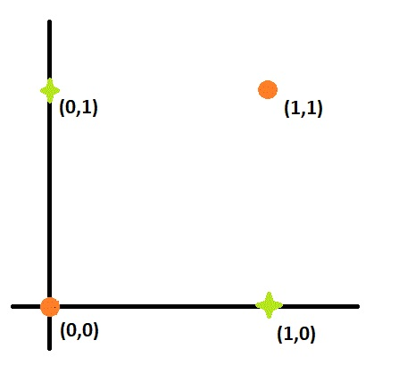
Linearly Separable Problem
AND Logic Gate plot

Slide 6
Limitation of a Single Perceptron
XOr Logic Gate plot
Try to find a single straight line to group the outcome

Slide 7
XOr Logic Gate plot
Limitation of a Single Perceptron

Slide 8
XOr Logic Gate plot
Limitation of a Single Perceptron
Not linearly separable

Slide 9
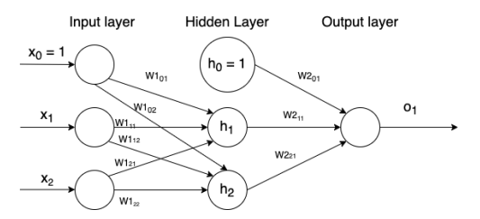
Multi-Layered Perceptron

Slide 10
Sigmoid Prime Activation Function

Slide 11
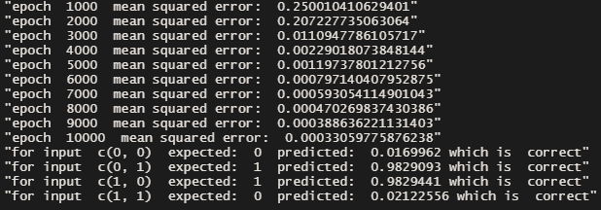
XOr Gate Results

Slide 12
Image Classification
The next step.

Slide 14



Slide 15
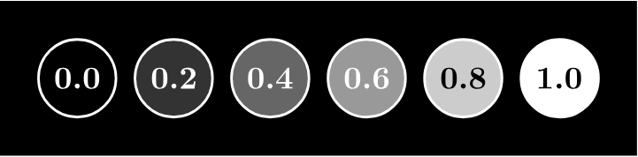
Greyscale Pixels

Slide 16
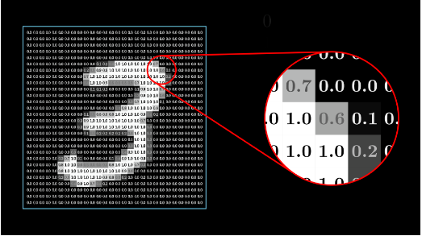

Slide 17
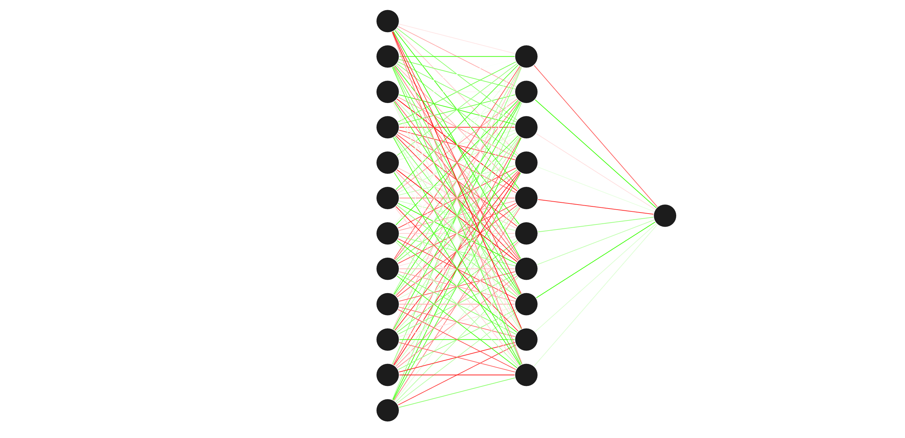





Slide 18
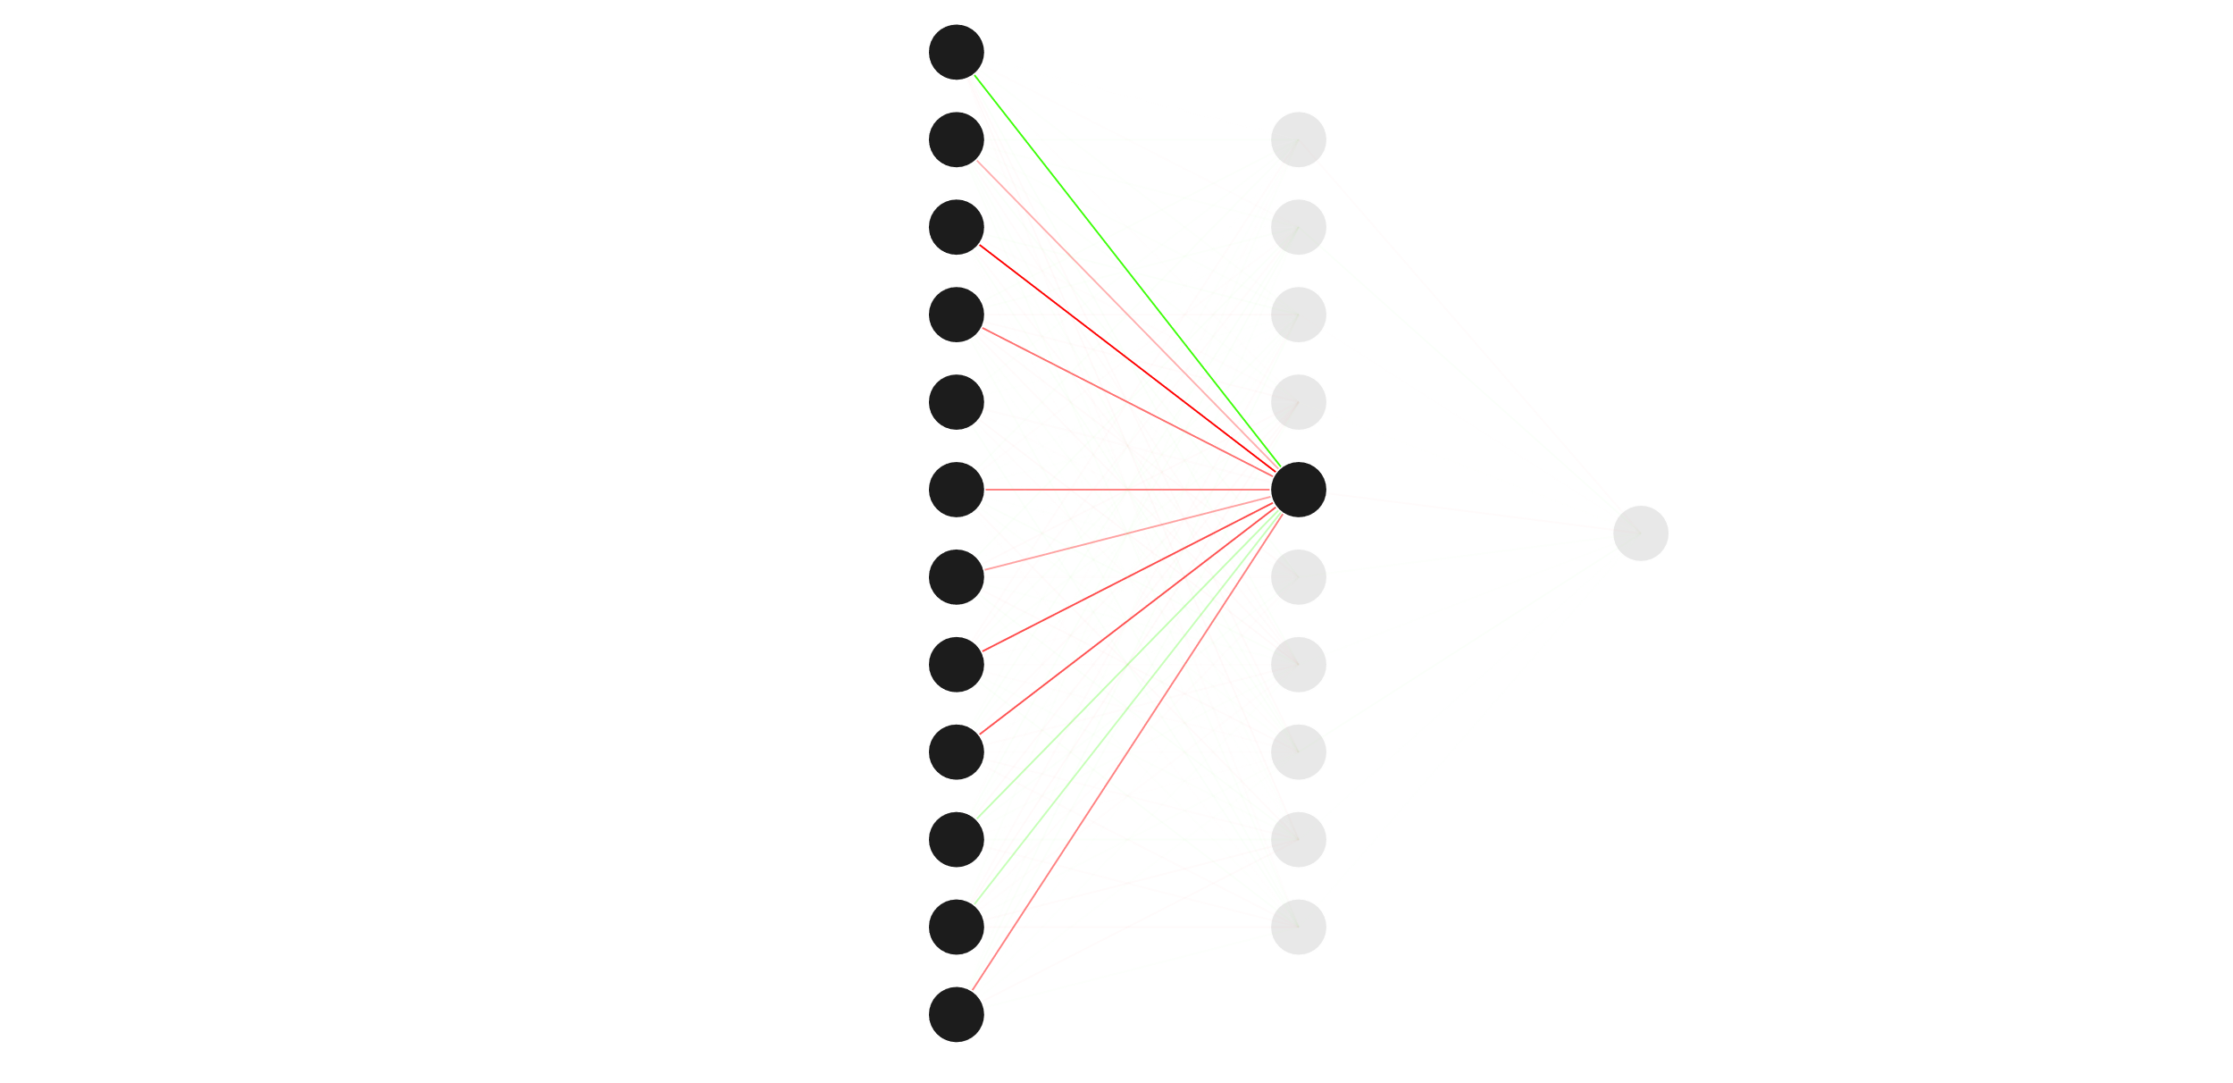

Slide 19
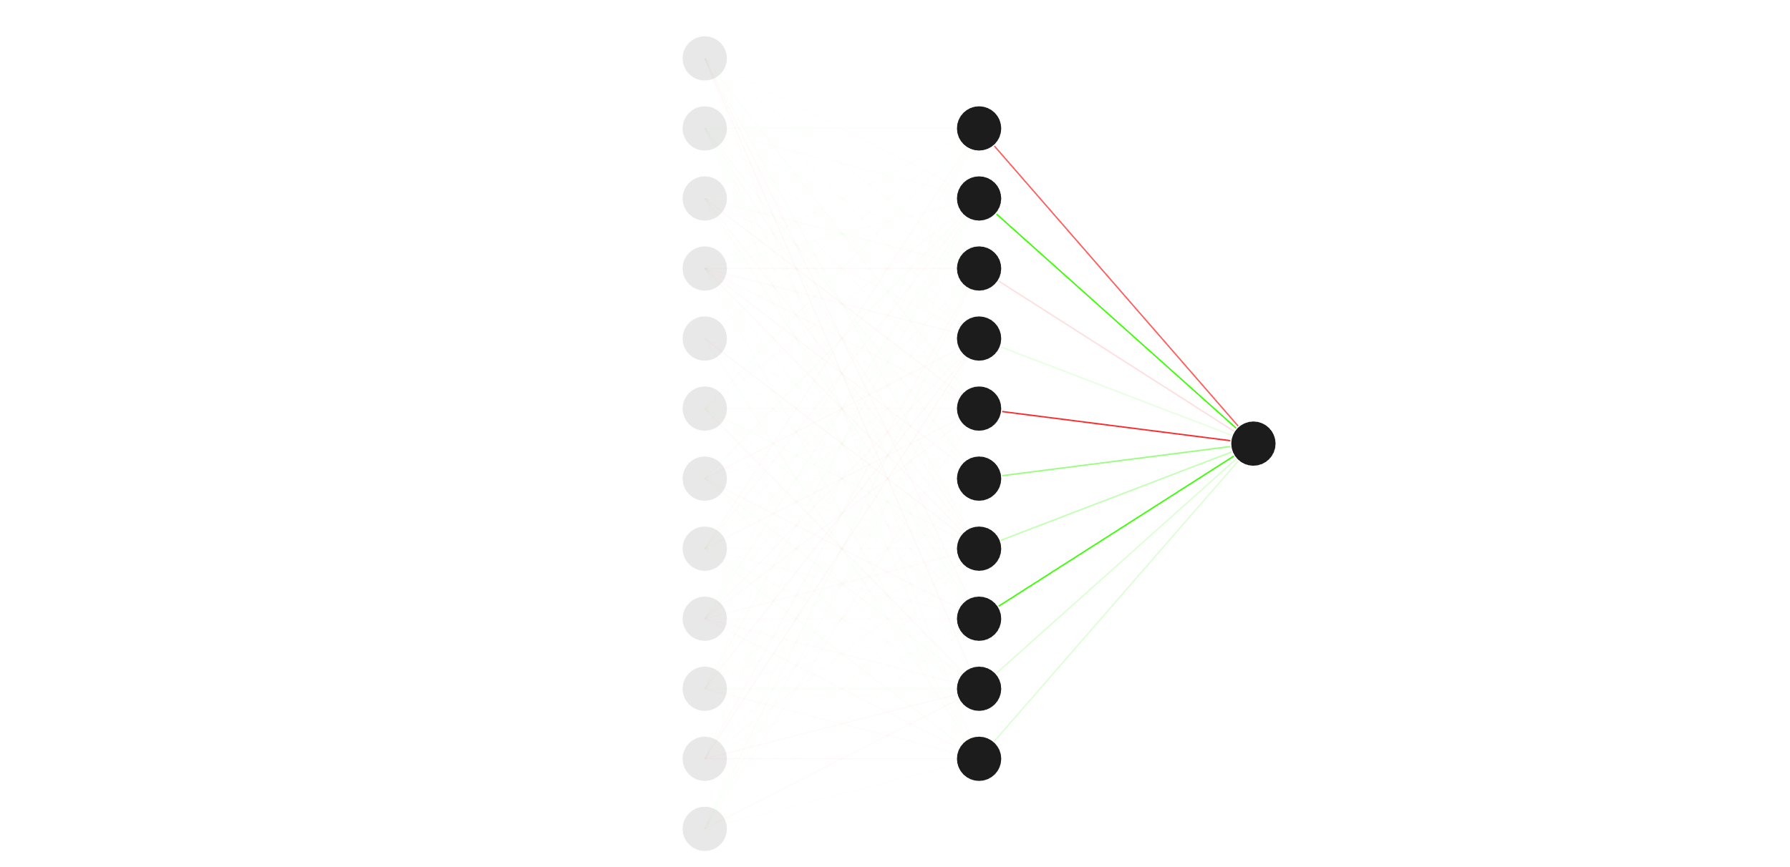

Slide 20
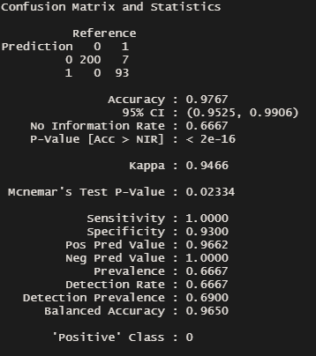
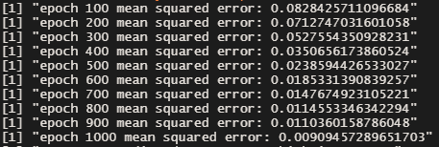
Shape Classification results
*
*Label of 0 refers to non-circle, 1 to a circle

Slide 21
Health Care Application
X-ray Images
Retinal Fundas Images
Optical Coherence Tomography (OCT)
Skin lesion Images
MRI Scan Images

Slide 22
Brain Tumour Detection
Early detection and classification of brain tumours is an important research domain in the field of medical imaging
Increasing volume and complexity of medical data requires a more efficient may to locate the tumours, saving the doctors time and allowing for relocation of the hospitals’ resources
Prone to human error; missing or misdiagnosing tumours can be extremely costly for the patient
Sensitivity of the model can be adjusted to try and catch edge cases or harder to spot cases

Slide 23
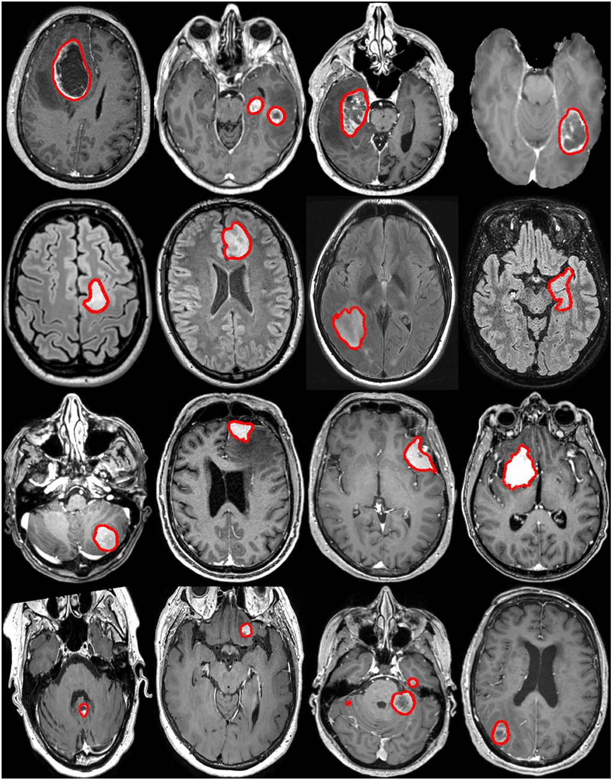
Applying Previous Model
Brain tumours are essentially a collection/mass of abnormal cells within the brain.
The Model should be able to detect the contour and outlines of the tumours using the same theory applied to the shape classification

Slide 24
Brain Tumour MRI Dataset
Combination of the following 3 datasets:
- SARTAJ dataset
- figshare
- Br35H
Contains 7023 images of human brain MRI images
Separated into the following 4 classes:
- Glioma
- Meningioma
- Pituitary
- No tumour
For this research, all types of tumours are grouped as the focus is to detect the presence of a tumour, not the type

Slide 25
Data Preprocessing
All images scaled to 128x128
Colours converted to grayscale
Colour values scaled between 0 and 1
Number of input nodes adjusted to the image size
128 x 128 = 16384 input nodes

Slide 26
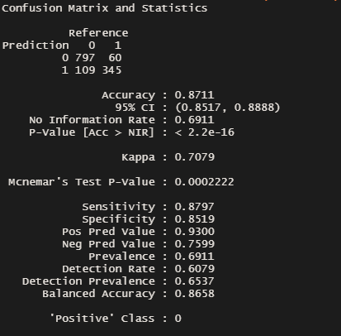
Brain Tumour presence results
Results after 10 epochs*
Given enough time and resources, the model could be left running to improve the accuracy of the model
*Runtime around 4 hours, 14gb of data

Slide 27
Clinical Trial – SRH-AI Technology
Study conducted by the National Cancer Institute (NCI) on the potential utilisation of AI in Brain Tumour Diagnoses
280 patients involved in the clinical trial
“Can accurately diagnose brain tumours in fewer than 3 minutes”, in comparison to intraoperative pathology analysis, which usually takes a significantly longer time
Can precisely diagnose the margins between the tumour and healthy brain tissue.
Algorithm had an accuracy of 94.6%, whereas the pathologist-based analysis had an accuracy rate of 93.9%.
Concluded that a combination of AI and cross-checking by a pathologist ensures the highest diagnostic accuracy.

Slide 28
MRI-based Brain Tumour Classification study
Study conducted by Andrés et al. focused on developing an accurate AI model to detect brain tumours, as well as diagnose the type within patients.
They managed to achieve an accuracy of 97% for the classification of meningioma, glioma, pituitary-type, and no tumour.

Slide 29
Limitations
Brain Tumour MRI Dataset

Slide 30
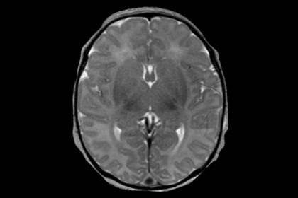
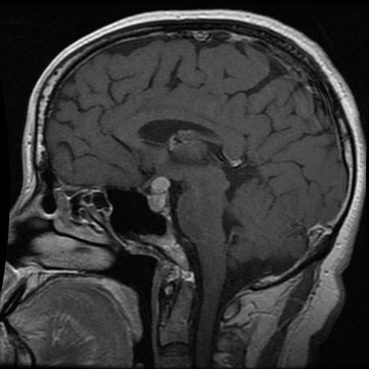
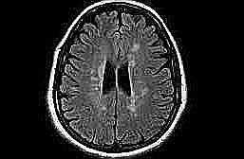
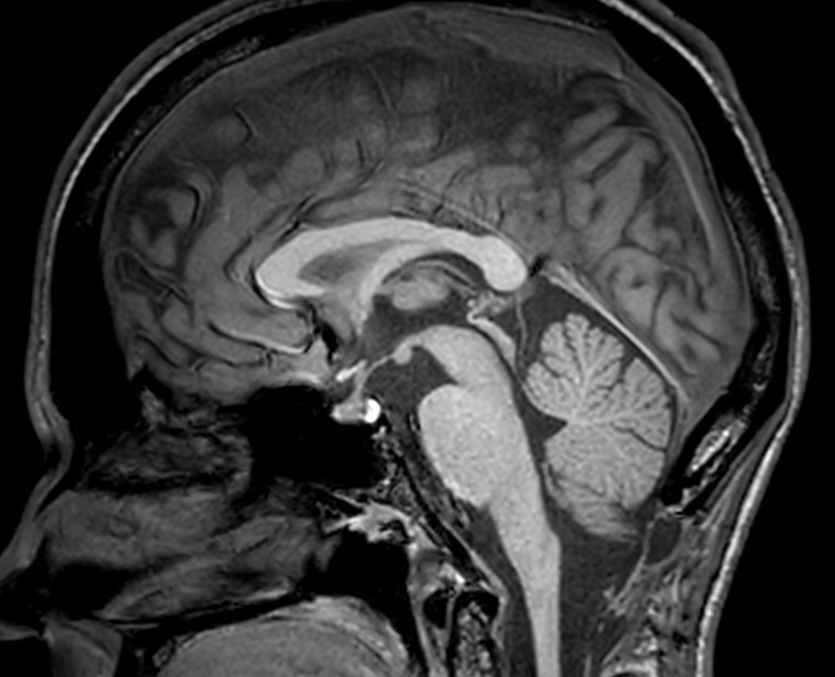
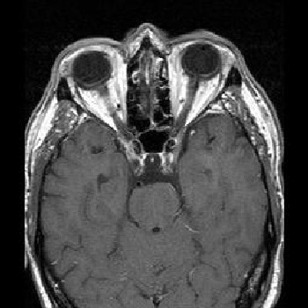
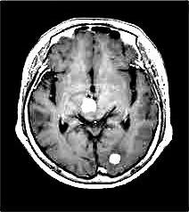
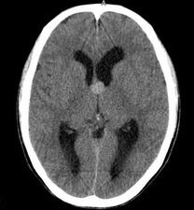
Limitations

Slide 31
Timely
Learning time can take a long time initially, however time saved in the long run makes up for it
Costly
Due to the size of the image files, and the likely large quantity of training data required to train the model, computation costs and storage could be a considerable downside
Inaccuracies
The varying size and perspectives of the MRI images can cause inaccuracies within model, all images are required to be the same size due to the set amount of input nodes, resulting in squashed images are used for training

Slide 32
Thank you for your time, any questions?

Slide 33
References
AI Technology & Systems (2021) Shape images classification using NN, Medium. Available at: https://medium.com/ai-techsystems/shape-images-classification-using-nn-5c74c1a4a5ee (Accessed: 11 September 2023).
Anaya-Isaza, A. et al. (2023) ‘Optimizing MRI-based brain tumor classification and detection using AI: A comparative analysis of neural networks, transfer learning, data augmentation, and the cross-transformer network’, European Journal of Radiology Open, 10, p. 100484. doi:10.1016/j.ejro.2023.100484.
Anoushka, S. (no date) Solving XOR problem using multi layer perceptron, Solving XoR problem using MLP. Available at: https://niser.ac.in/~smishra/teach/cs460/2020/lectures/lec19/ (Accessed: 11 September 2023).
Bouget, D. et al. (2022) ‘Preoperative Brain Tumor Imaging: Models and software for segmentation and standardized reporting’, Frontiers in Neurology, 13. doi:10.3389/fneur.2022.932219.
Faes, L. et al. (2019) ‘Automated Deep Learning Design for medical image classification by health-care professionals with no coding experience: A feasibility study’, The Lancet Digital Health, 1(5). doi:10.1016/s2589-7500(19)30108-6.
jacek (no date) Coding games and programming challenges to code better, CodinGame. Available at: https://www.codingame.com/playgrounds/59631/neural-network-xor-example-from-scratch-no-libs (Accessed: 11 September 2023).
NCI Staff (2020) ‘Artificial Intelligence Expedites Brain Tumor Diagnosis during Surgery’, Cancer.gov. NIH (National Cancer Institute), 12 February. Available at: https://www.cancer.gov/news-events/cancer-currents-blog/2020/artificial-intelligence-brain-tumor-diagnosis-surgery (Accessed: 11 September 2023).
Nickparvar, M. (2021) Brain tumor MRI dataset, Kaggle. Available at: https://www.kaggle.com/datasets/masoudnickparvar/brain-tumor-mri-dataset?resource=download (Accessed: 11 September 2023).
Saeed, M. (2021) A gentle introduction to sigmoid function, MachineLearningMastery.com. Available at: https://machinelearningmastery.com/a-gentle-introduction-to-sigmoid-function/ (Accessed: 11 September 2023).

